Slide 1
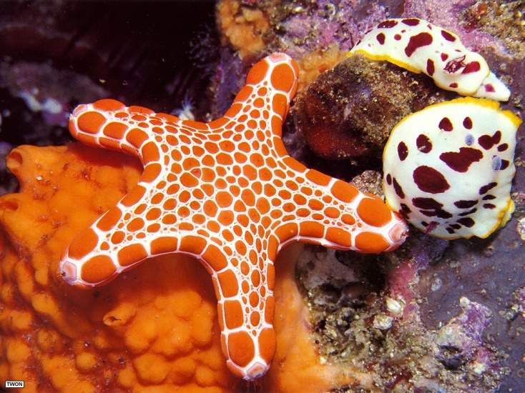
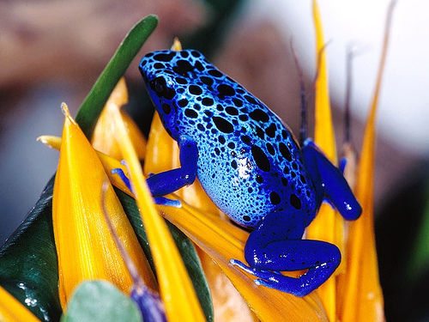
Let Nature Solve it!

Slide 2
This Strategy falls
Under investigation and
research

Slide 3
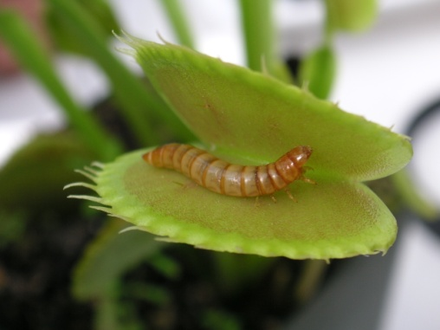
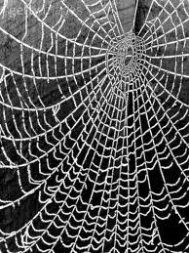
HOW?
Sometimes designers assess animals, plants and other aspects of nature in order to solve design problems.
You may be surprised by looking around you how things can be inspired by nature.
Soon you will see some sample problems that can be solved by nature.
Hopefully they will spark off a thought for you to find a solution the your design problem.

Slide 4
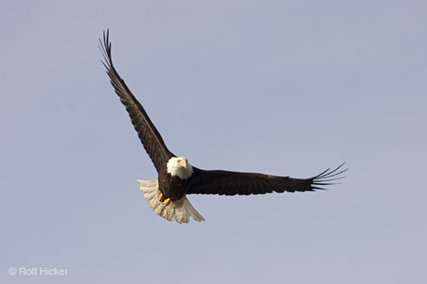
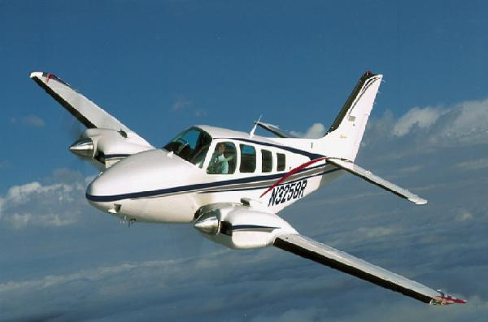
How to transport man in the air?
This is probably the most obvious design solved by nature that you will see.
Bird wings
Aeroplane

Slide 5
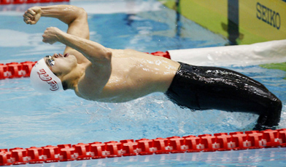
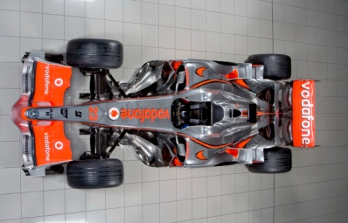
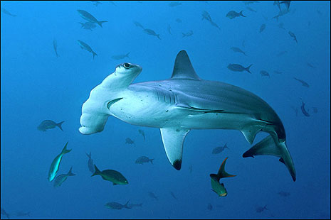
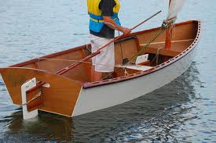
How to increase speed in water?
Sharkskin swimwear
How to increase downward pressure and stability on an F1 car? Front spoiler (hammer head)
How to direct a water vessel? The rudder (Shark fin)

Slide 6
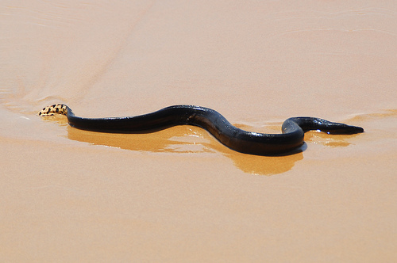
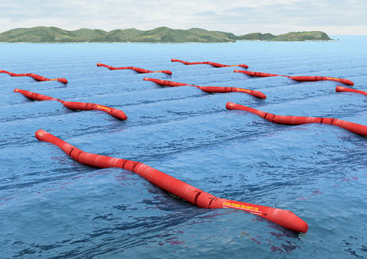
Here is an interesting one:
Sea Snake
Renewable tidal energy
Man needed to find a way to capture tidal energy efficiently. Inspiration was taken from the way a yellow bellied sea snake can swim along the surface of the water. Its shape and swimming action resulted in the design solution above.

Slide 7
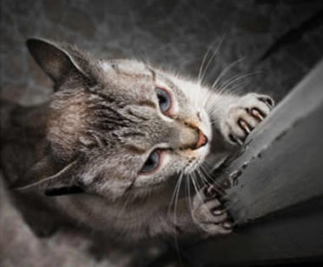
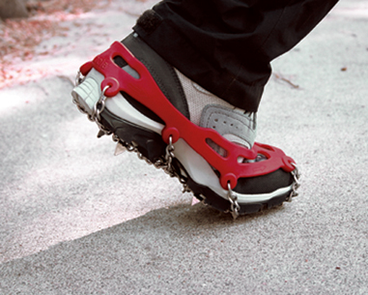
Naturally, humans have relatively no grip on their feet. We needed more grip whether it was for ice/sport/mountain-climbing. Nature may have inspired us to create artificial claws (studs) on our feet to provide more grip- thus solving the problem.
Cats claws
Spiked/studded boots

Slide 8
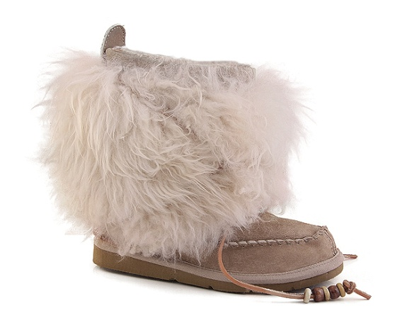
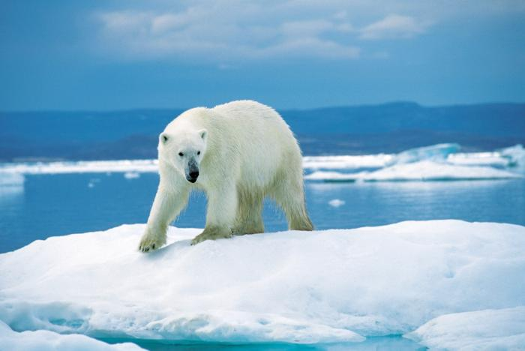
Warmth and weight distribution:
The Eskimo’s created a special shoe with a wide sole to distribute weight in the snow and ice. They also incorporated animal skin and fur for warmth.

Slide 9
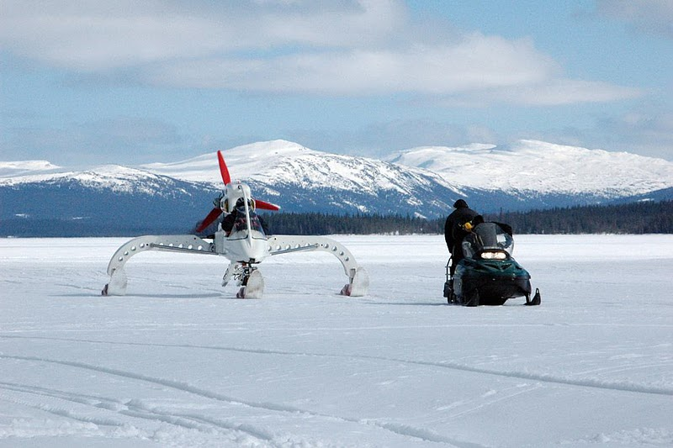
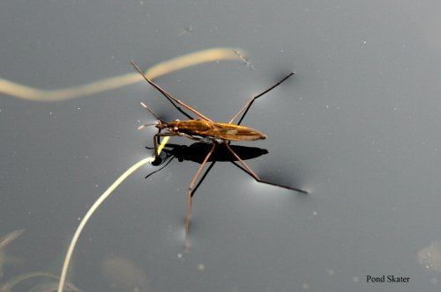
The design of the snow mobile has been advanced: based on the design of the pond skater insect who distributes its weight across a wide area, with minimal contact with the water to allow for speed.
Pond skater
Modern snow mobile

